Slide 1
ENERGY CONSUMPTION AND PREDICTION Project
M.Harshitha

Slide 2
Contents:
Project Objective and Overview | The project aims to analyze household energy consumption patterns and forecast future demand using data exploration, visualization, and predictive modeling.
Milestone 1 | Basic Data Exploration
Milestone 2 | Data Visualization and Encoding
Milestone 3 | Model Creation and Comparison
Milestone 4 | Time Series Forecasting With ARIMA And Prophet
Model Evaluation | Model evaluation using metrics to assess accuracy and performance of predictive models
Conclusion | Summarizing Insights and Recommendations For Optimizing Household Energy Consumption.

Slide 3
Dataset:
Household Power Consumption File
(DriveLink):
https://drive.google.com/file/d/1WNves9Pqb7zSbab_hUFZdZAppuoOPI7w/view?usp=sharing

Slide 4
Project Objective:
This project focuses on analyzing household energy consumption data with the following objectives:
Detecting energy usage patterns and variations across time and appliances.
Identifying peak energy demand periods to understand when usage is highest.
Tackling data issues like missing values and fluctuations to ensure reliable analysis.
Forecasting future energy needs using advanced time-series prediction models.
Providing practical recommendations to optimize energy usage and improve efficiency.

Slide 5
Project Overview:
This project involves analyzing household energy usage through a dataset comprising minute-level details on power consumption, voltage, current intensity, and appliance-specific data.
Key Milestones:
Data Exploration: Examined the dataset structure and resolved missing data issues.
Visualization & Feature Engineering: Identified trends and integrated time-based features for analysis.
Model Development: Created regression models to study energy consumption patterns.
Forecasting: Applied ARIMA and Prophet models to predict future energy usage.
Outcome:
Delivered actionable insights into energy consumption trends and developed models for precise forecasting.

Slide 6
MILESTONE-1 (BASIC DATA EXPLORATION)

Slide 7
Dataset Description:
Key Features:
Global Active Power: Represents the total active power energy consumed.
Global Reactive Power: Indicates the energy used to maintain electric and magnetic fields.
Voltage: Measures the household power supply voltage.
Global Intensity: Reflects the combined current intensity within the household.
Sub-metering 1, 2, 3: Tracks energy usage for lighting, HVAC (heating, ventilation, and air conditioning), and kitchen appliances.
Dataset Size:
Rows: 1,200,000
Columns: 7

Slide 8
Initial Data Analysis:
df.head(): Displays the first 5 rows of the dataset, offering a quick glimpse into its structure and variables.
df.shape: Shows the dataset dimensions, with over 2 million rows and 9 columns, giving a clear sense of its size.
df.info(): Summarizes the dataset by highlighting data types, the number of non-null values, and noting that most features are of type 'object,' except for 'Sub_metering_3,' which is numeric.
These functions are essential for initial dataset understanding:
df.head() provides a snapshot of the data's structure and content.
df.shape assesses dataset size by detailing the number of rows and columns.
df.info() identifies data types, missing values, and areas needing type conversions or cleaning.

Slide 9
Analysis and Handling of Missing Data :
Missing data was identified and handled using multiple strategies. Columns with gaps were addressed by filling them with default values such as zero, the mean, or the median of the respective column. In some instances, rows containing missing values were removed to ensure the dataset remained clean and reliable. These steps were vital for preparing the data for detailed analysis and model building.

Slide 10
Data Visualization and Key Insights :
Visualizations like histograms and boxplots were employed to study power consumption patterns, while a correlation heatmap revealed relationships between features. Time-based features were introduced by converting 'Date' and 'Time' into a datetime format and extracting details like hour, day, and month for a more detailed analysis.
During exploration, it was observed that 'Sub_metering_3' had the most missing values, which were addressed by imputing with the mean, median, or zero. These strategies resulted in a cleaner dataset, enabling better analysis.
Recommendations include leveraging time-series models that incorporate the new datetime features for improved forecasting accuracy and further refining the dataset by removing outliers and noise to enhance prediction reliability.

Slide 11
Analysis:
Functions | Use case | Observations
df.head() | Displays the first 5 rows of the dataset to preview its structure and values. | We can see the first 5 rows of our dataset
df.tail() | Displays the last 5 rows of the dataset to inspect the end of the data. | We can see the last 5 rows of our dataset
df.shape | Returns the number of rows and columns in the dataset. | The number of rows and columns are displayed(2075259, 9)
df.info() | Provides a summary of the dataset, including data types and non-null counts. | We can see that only sub_metering3 is of float type all others are object type.
df.describe() | Generates summary statistics (mean, std, min, max, etc.) for numeric columns. | The respective values are displayed
df.isnull().sum() | Identifies the number of missing values in each column. | Sub_metering3 has 25979 null values
df.fillna(0) | Fill the null value with 0’s. | After filling it shows some rows of our data.
df.fillna(df['Sub_metering_3'].mean()) | Fills the null values with the mean of the column. | After filling with the mean it outputs some sample of data.
df.fillna(df['Sub_metering_3'].median()) | Fills the null values with the median of the column. | After filling with the median it outputs some sample of data.
df.unique() | Lists the unique values in a column. | It displays number of unique values in each column

Slide 12
Milestone 2:
(DATA VISUALISATION AND ENCODING)

Slide 13
Process:
Objective: Preprocess the dataset for power consumption forecasting
Key Steps:
To identify missing values and non-numeric data.
Addressing missing values by converting non-numeric entries to NaN and filling missing data with any value.
Outcome:
We will achieve a cleaned dataset with no missing and null values .It will be prepared for further analysis and feature engineering.

Slide 14
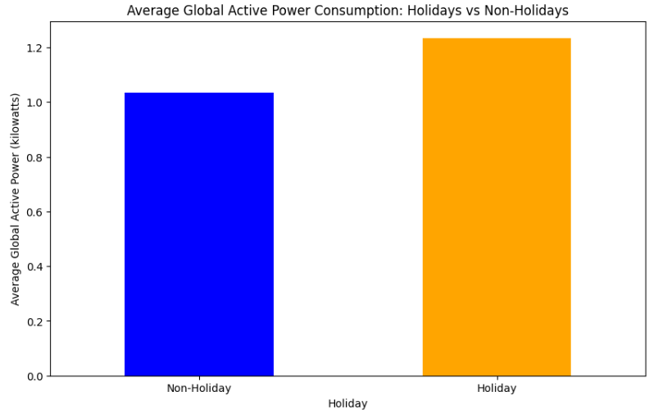
Feature Engineering – Holiday identification:
Objective: Active consumption for a Given Year
Approach:
Added a 'year' column to the dataset, where:
Key Findings:
Current dataset only contains records labeled as column for year.
The average active energy consumption on rows.
Next Steps:
Collect and incorporate non-holiday data point

Slide 15
Feature Engineering - DateTime:
Objective: Determine Daylight Status for Each Record
Approach:
Developed a function, is_light(hour), to assess whether a given hour falls within daylight hours (6:00 AM to 6:00 PM).
Added a 'Light' column indicating daylight status:
1 for daylight hours.
0 for non-daylight hours.
Outcome:
All records in the dataset fall within daylight hours, resulting in the 'Light' column being uniformly set to 1.

Slide 16
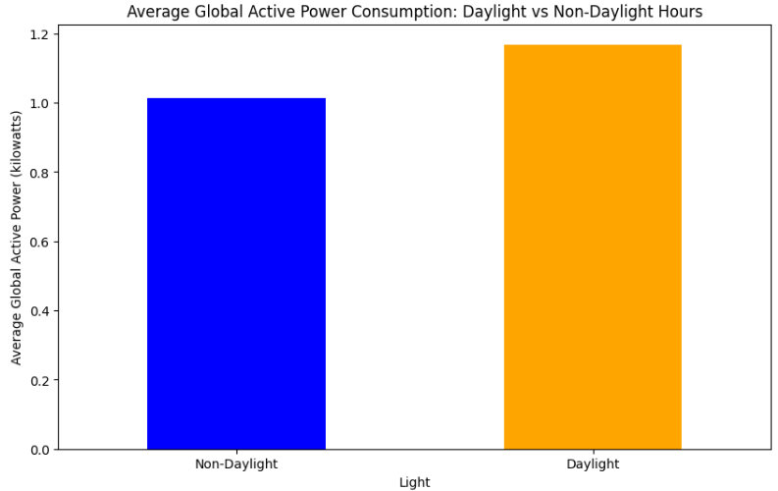
Feature Engineering - Sunlight:
Objective: Determine Daylight Status for Each Record
Approach:
Developed a function, is_light(hour), to assess whether a given hour falls within daylight hours (6:00 AM to 6:00 PM).
Added a 'Light' column indicating daylight status:
1 for daylight hours.
0 for non-daylight hours.
Outcome:
All records in the dataset fall within daylight hours, resulting in the 'Light' column being uniformly set to 1.

Slide 17
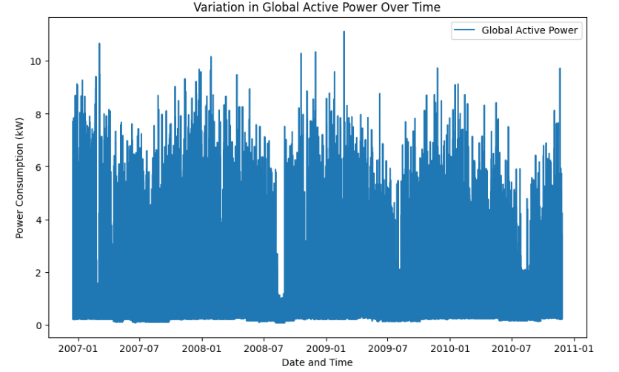
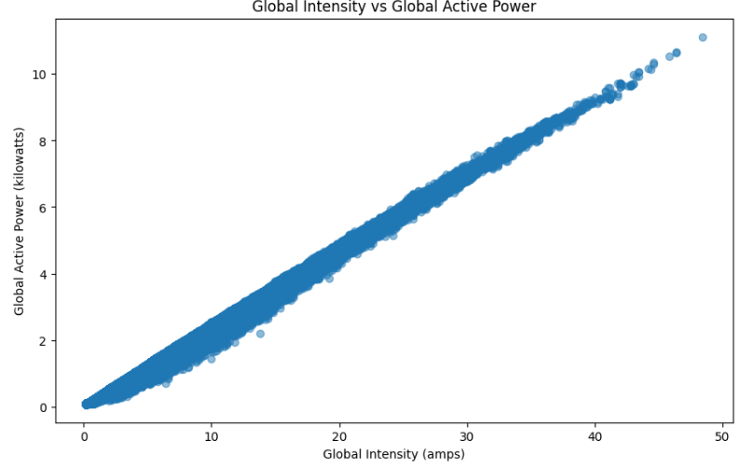
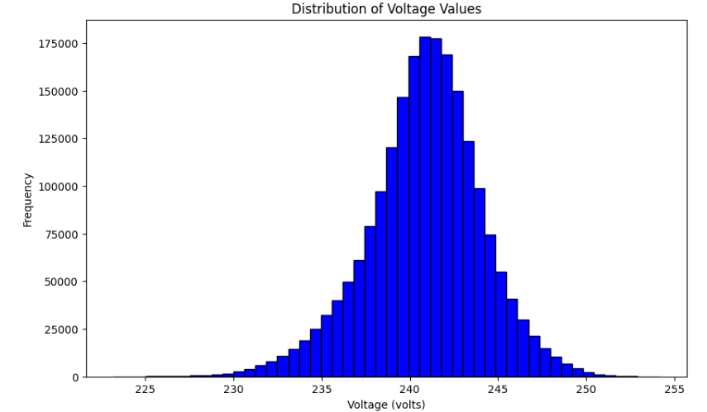
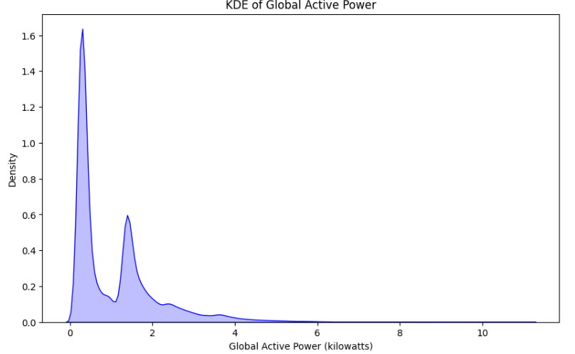
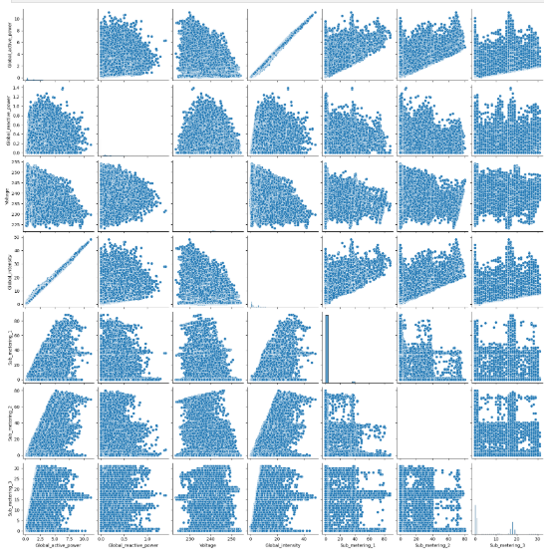
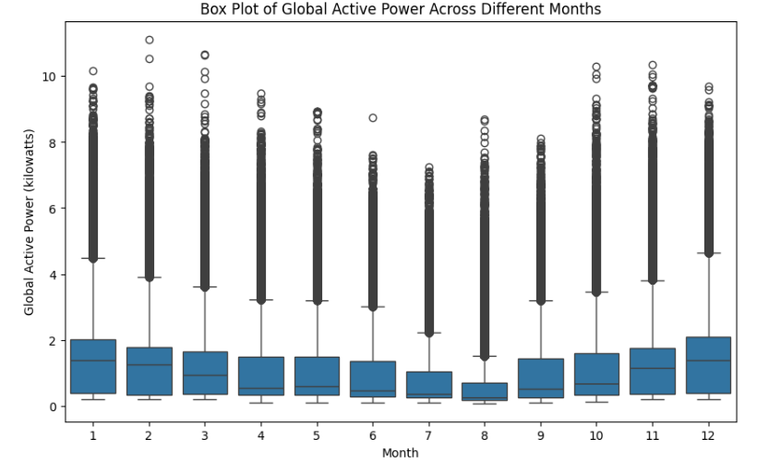
Plots:

Slide 18
Graphical Insights into Power Consumption:
Global Active Power Over Year
Visualization: Bar plot of Global_active_power against Year.
Insight: The Global_active_power is maximum in year 2009
Voltage vs. Global Active Power
Visualization: Scatter plot comparing Voltage and Global_active_power.
Insight: A strong positive correlation suggests that higher intensity corresponds to greater power consumption.
Density value for Voltage
Visualization: Kdeplot of Voltage values.
Insight: Voltage peak density is 0.12

Slide 19
Graphical Insights into Power Consumption:
Meter reading and which meter is used the most
Visualization: Pie chart of Sub_metering_1,Sub_metering_2,Sub_metering_3.
Insights: Based on the meters reading Sub_metering_3 is having high reading and Sub_meter 3 is used more than the other 2 Sub_meters.
Global Active Power vs. Global Reactive Power
Visualization: Scatter plot comparing Global_active_power and Global_reactive_power.
Insights: Global_active_power and Global_reactive_power are strongly correlated, which means that when one is high, the other is also likely to be high.
Voltage vs. Global Intensity
Visualization: Scatter plot comparing Voltage and Global_intensity.
Insights: Voltage and Global_intensiy seems to be a positive correlation between them. This is likely because higher voltage leads to higher current

Slide 20
Analysis and Recommendations:
Average Power Consumption Analysis
Average active power consumption:
Visualization: Bar plot showing average active power consumption for years.
Insight: Power consumption is noticeably higher on particular years.
Years:
Visualization: Bar plot depicting average active power during particular years.
Insight: Peak power consumption occurs during 2004.

Slide 21
Analysis and Recommendations:
Conclusions and Recommendations
Summary:
Addressed data gaps and standardized data types for consistency.
Created new features such as 'Average active power consumption', 'Year'.
Recommendations:
Conduct a detailed exploration of year-based power usage patterns leveraging the engineered features.
Employ year-series models to forecast future power consumption trends.
Identify and address outliers to enhance prediction accuracy and reliability.

Slide 22
Milestone 3:
(MODEL CREATION AND COMPARISON)

Slide 23
Regression Models Overview:
Linear Regression:
Linear Regression fits a straight line to the data by minimizing the difference between predicted and actual values. It is effective when there is a strong linear relationship in the data but may suffer from overfitting. It is ideal for creating simple, interpretable models without regularization.
Lasso Regression:
Lasso Regression adds a penalty that shrinks coefficients, with some even becoming zero, performing automatic feature selection. This reduces model complexity and highlights the most important predictors. However, it may result in slightly lower accuracy compared to Ridge or Linear Regression.
Ridge Regression:
Ridge Regression penalizes the square of the coefficients, shrinking them toward zero but keeping all features in the model. It helps prevent overfitting and works well for datasets with multicollinearity. It is useful when you need a balance between model accuracy and complexity, particularly when all features are relevant.

Slide 24
Training and Testing:
The data is divided into training (80%) and testing (20%) sets to assess the model's performance. The models—Linear, Lasso, and Ridge Regression—are trained on the training set and evaluated on the unseen testing set to gauge their ability to generalize. Model performance is assessed using metrics such as Mean Squared Error (MSE).

Slide 25
Training and Testing:
Ridge Regression performs well with complex, correlated datasets by regularizing without removing variables. Lasso Regression is useful for feature selection but may lose accuracy by eliminating too many features. Linear Regression is simple but prone to overfitting and is typically outperformed by Ridge and Lasso.

Slide 26
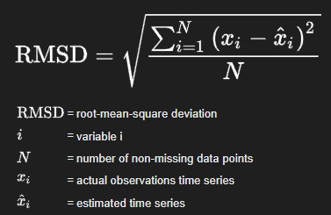

Performance Metrics:
Root Mean Squared Error (RMSE)
Definition: Measures the average magnitude of the prediction error. It gives an idea of how much error is in the model’s predictions. The lower the RMSE, the better the model.
Use Case: Used to evaluate the accuracy of regression models by measuring the difference between predicted and actual values.

Slide 27
Performance Metrics:
R² Score
Definition: Measures how well the model explains the variance in the data. A score of 1 indicates perfect fit, while 0 indicates no explanatory power.
Use Case: Used to determine the goodness of fit for regression models.

Slide 28
Milestone 4:
05
(TIME SERIES FORECASTING WITH ARIMA
AND PROPHET MODELS)

Slide 29
Introduction to Time Series Forecasting:
Time series forecasting predicts future values based on historical data.
Common applications include sales predictions, stock prices, and energy consumption.
In this presentation, we will forecast energy consumption using two popular models: ARIMA and Prophet.

Slide 30
ARIMA Model:
(AutoRegressive Integrated Moving Average)
ARIMA is a statistical model for time series forecasting, combining:
AR (Auto-Regressive): Relationship with lagged observations.
I (Integrated): Differencing to make data stationary.
MA (Moving Average): Relationship with residual errors.
ARIMA is suited for data with trends but no seasonal patterns.

Slide 31
Steps to Implement ARIMA:
1.Data Preprocessing:
Load dataset, clean data, and handle missing values.
2.Splitting Data:
Split data into training and testing sets.
3.Model Creation:
Fit ARIMA model with selected order (p, d, q).
4.Model Evaluation:
Calculate performance metrics like RMSE to assess prediction accuracy.

Slide 32
Prophet Model:
Prophet is a forecasting tool for time series with daily observations and varying patterns across time scales.
Advantages:
Handles missing data effectively.
Models holidays and seasonality.
Does not require data stationarity.
Prophet is used for forecasting demand, sales, traffic, energy consumption, financial trends, and seasonal patterns in industries like retail and logistics.

Slide 33
Steps to Implement Prophet:
Data Preprocessing:
Convert the dataset into the format that Prophet requires.
Model Creation:
Fit Prophet model on training data.
Forecasting:
Predict future data points.
Model Evaluation:
Evaluate the forecast accuracy using RMSE or other metrics.

Slide 34
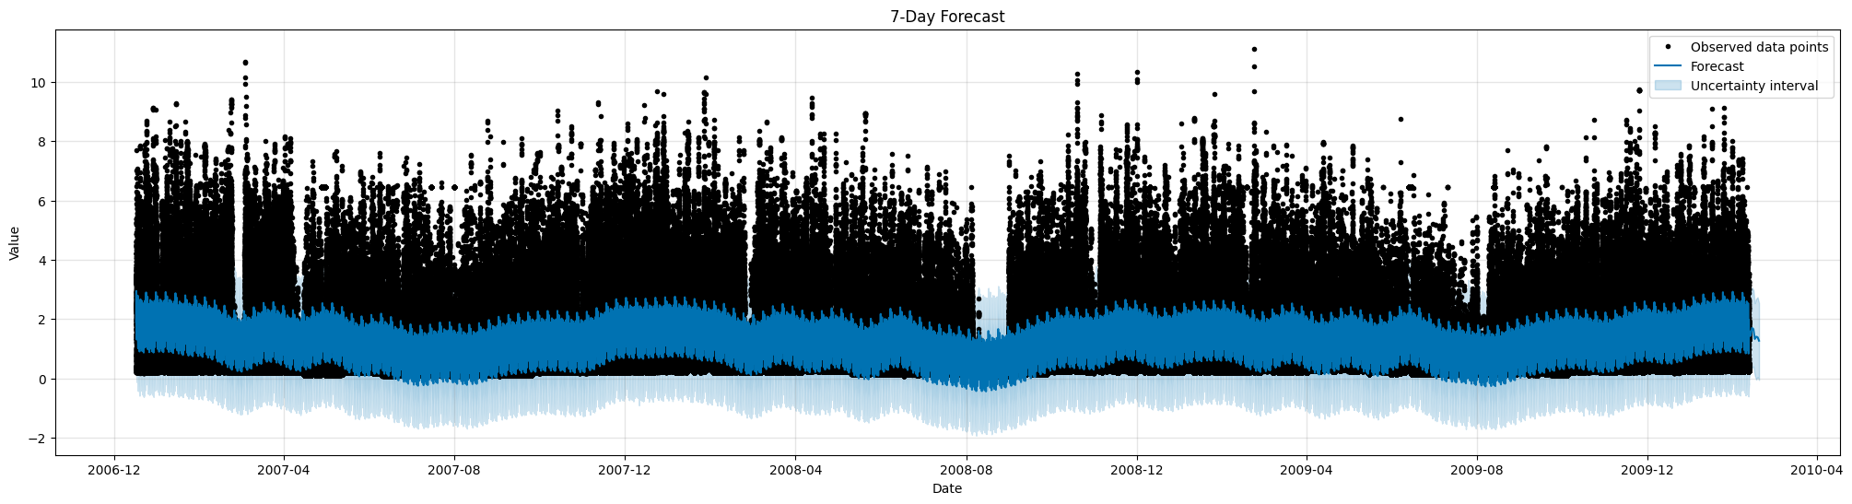
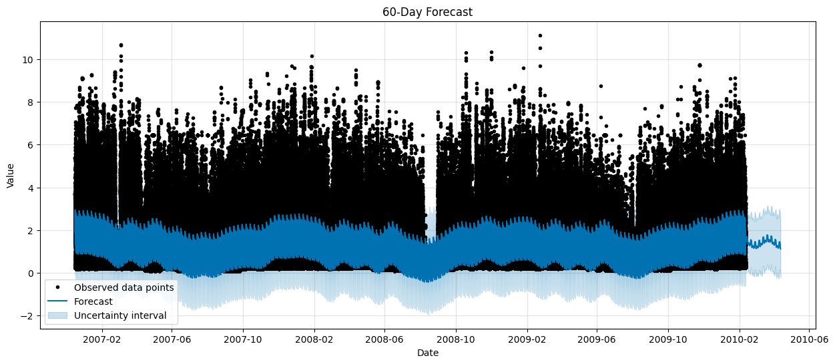
Plots from Prophet Model:

Slide 35
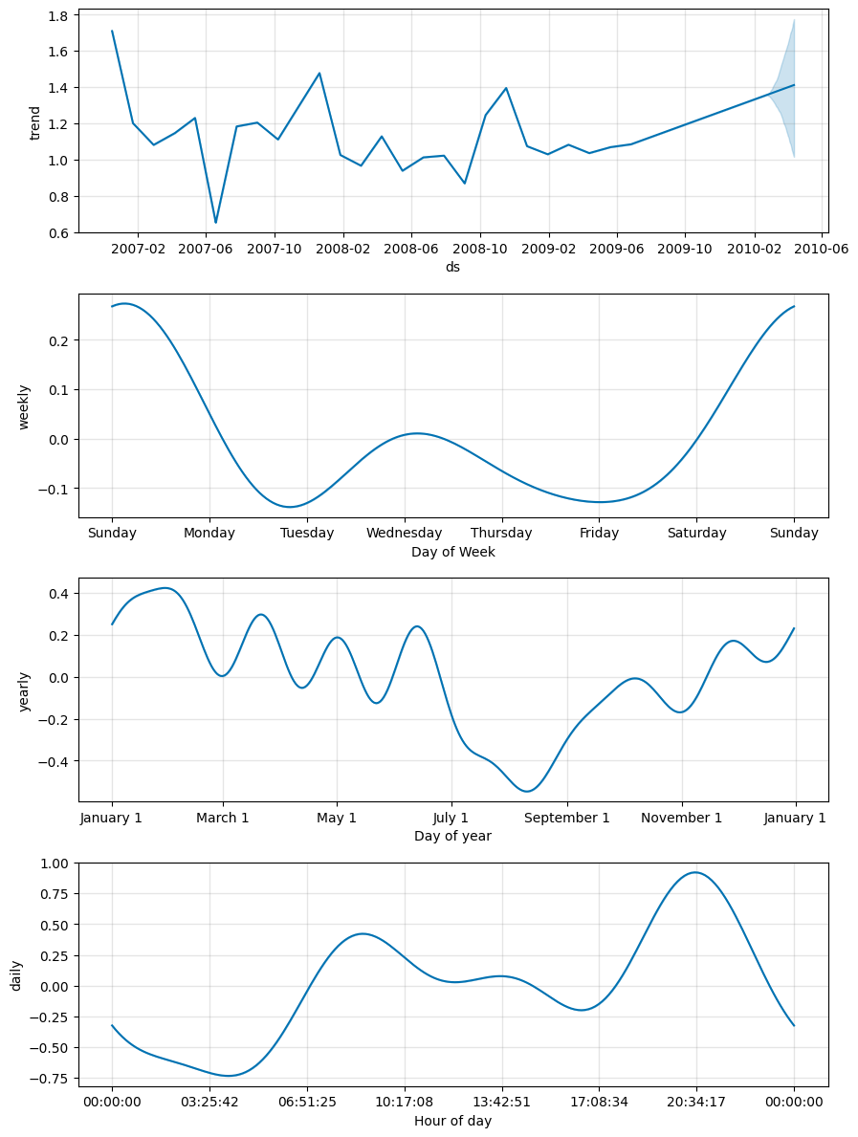
Component Analysis from Prophet Model:

Slide 36
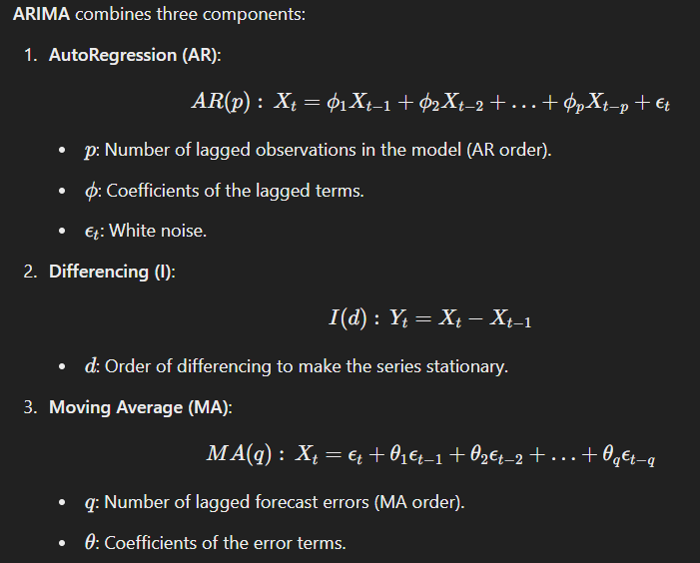
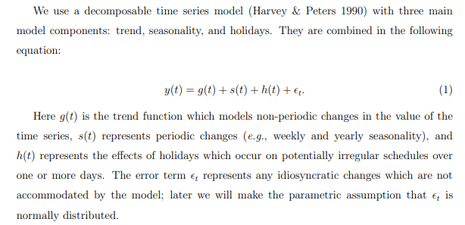
Mathematical Skeleton of the Models:
Prophet Model:
For More Info:
https://peerj.com/preprints/3190.pdf#pdfjs.action=download
https://people.duke.edu/~rnau/Mathematical_structure_of_ARIMA_models--Robert_Nau.pdf

Slide 37
Model Evaluation:

Slide 38


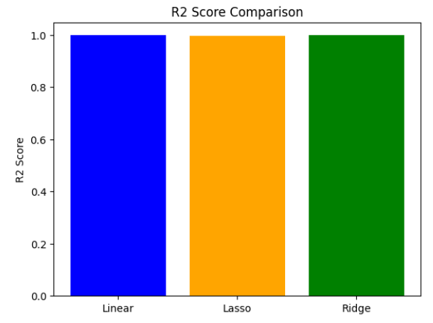
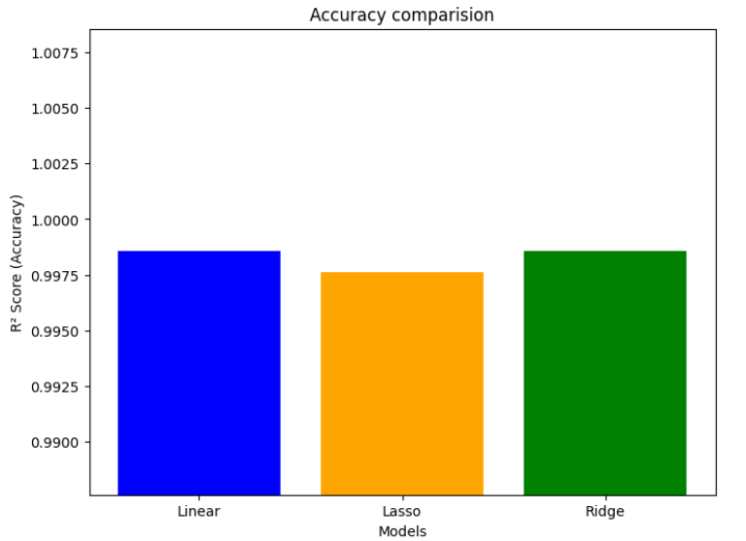
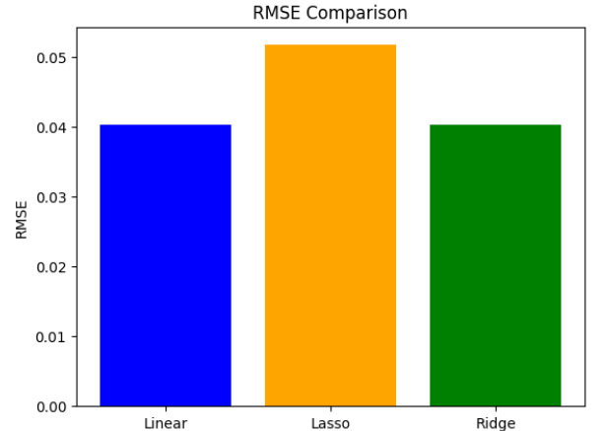
Regression Models:
Outputs:

Slide 39
Insights (Regression Models):
Linear and Ridge Regression perform similarly, with high R² and low RMSE. Lasso Regression trades some accuracy for simplicity by shrinking coefficients to zero.
RMSE Comparison: Lasso has the highest RMSE, indicating slightly higher prediction error. R² Score Comparison: Linear and Ridge Regression have nearly identical R² scores, showing they explain data variance similarly.

Slide 40
Results and Comparison (ARIMA and Prophet):
The ARIMA model (Order: 6,3,0) was evaluated using RMSE to predict energy consumption, uncovering key patterns. The Prophet model, suited for seasonal time series, was compared with ARIMA, emphasizing seasonal trends and holidays. Both models' forecast accuracy, including RMSE, was assessed through visual plots of forecasted vs. actual data.

Slide 41
Results and Comparison (ARIMA and Prophet):
ARIMA:
Best for stationary data.
Requires careful parameter selection (p, d, q).
Does not handle holidays or special events well.
Prophet:
Handles holidays and seasonal trends effectively.
Less sensitive to parameter tuning.
Works well with missing data.

Slide 42
THANK YOU

